Slide 1
Chapter 12
Introduction to Statistics
A random variable is one in which the exact behavior cannot be predicted, but which may be described in terms of probable behavior. A random process is any process that involves one or more random variables. The subjects of probability and statistics are based on a mathematical and scientific methodology for dealing with random processes and variables.

Slide 2
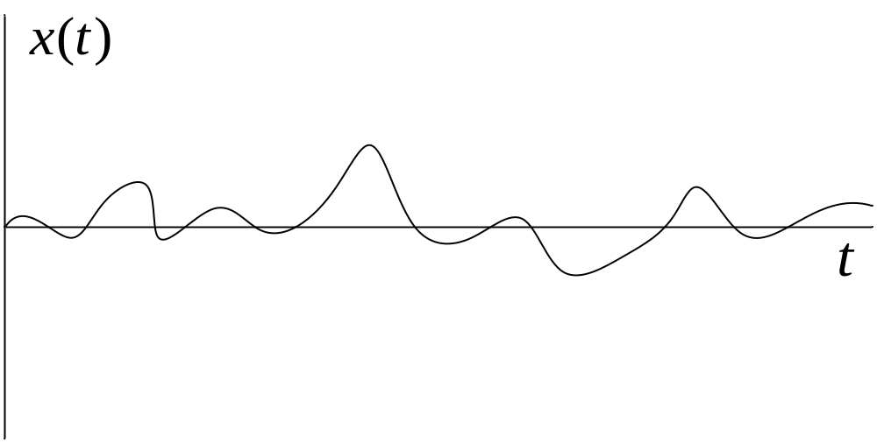
Figure 12-1. A random variable.

Slide 3
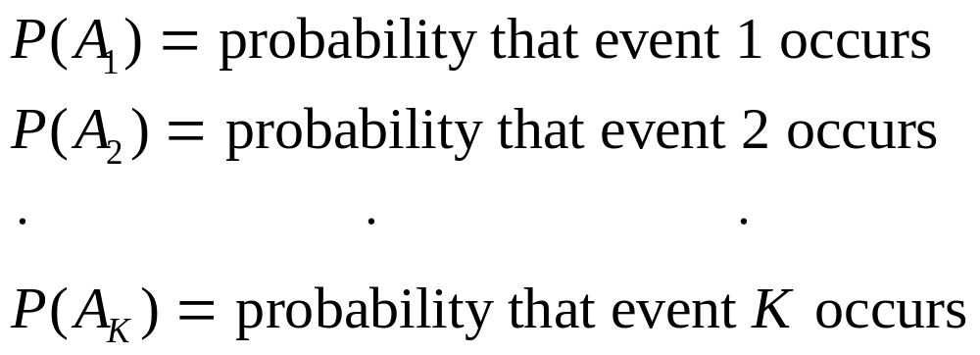
Probability
Probability is associated with the very natural trend of a random event to follow a somewhat regular pattern if the process is repeated a sufficient number of times.

Slide 4
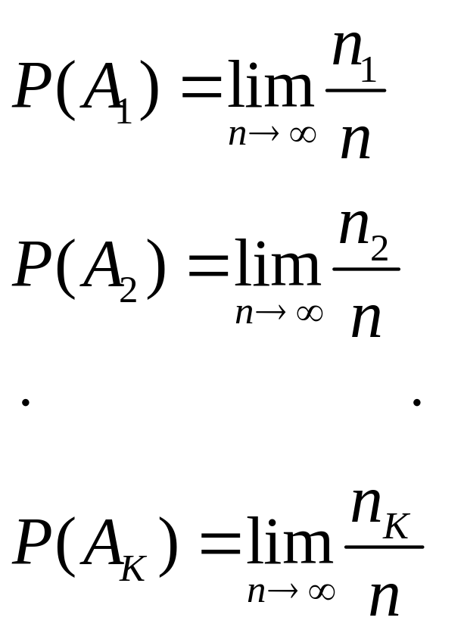
Probability
Assume that the first event occurs n₁ times, the second event n₂ times, and so on. The various probabilities are then defined as

Slide 5
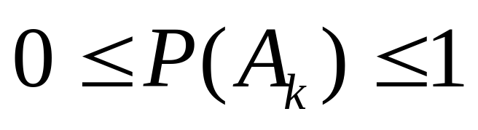
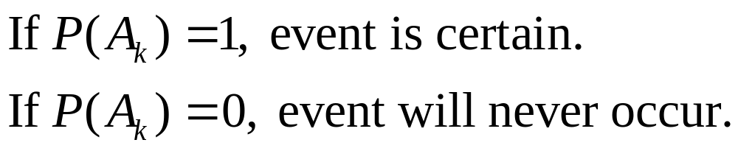
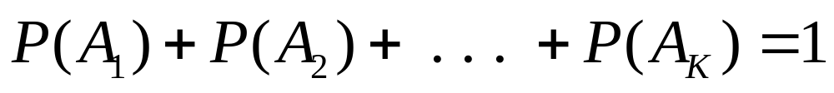
Probabilities Properties

Slide 6
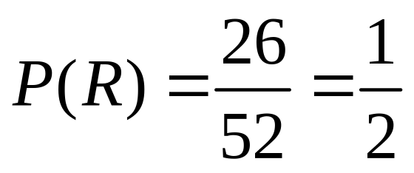
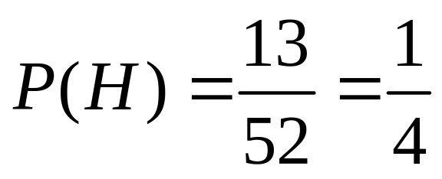
Example 12-1. For 52-card deck, determine probabilities of drawing (a) red card, (b) a heart, (c) an ace, (d) ace of spades, (e) ace of hearts or the ace of diamonds.
(a)
(b)

Slide 7
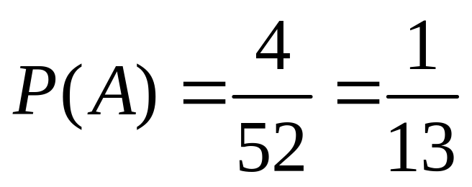
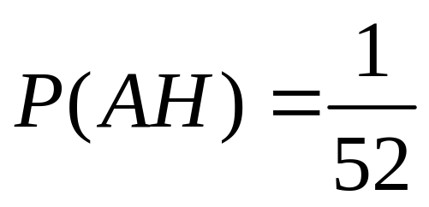
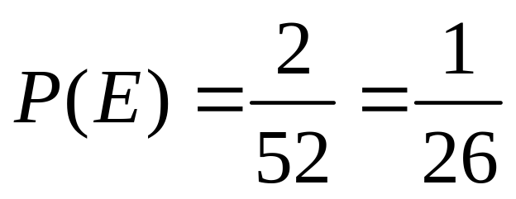
Example 12-1. Continuation.
(c)
(d)
(e)

Slide 8
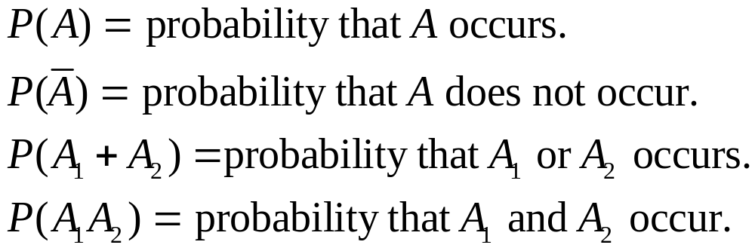
Probability Terminology

Slide 9
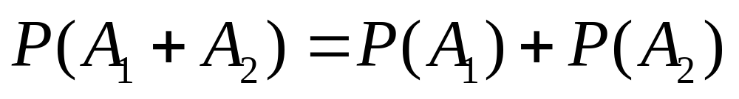
Mutual Exclusiveness
Let P(A₁+A₂) represent the probability that either A₁ or A₂ occurs. Two events are mutually exclusive if

Slide 10
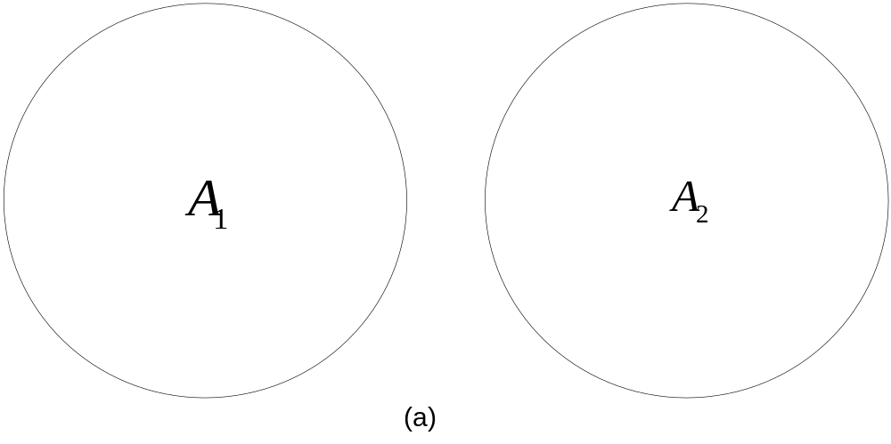
Figure 12-2(a). Events that are mutually exclusive.

Slide 11
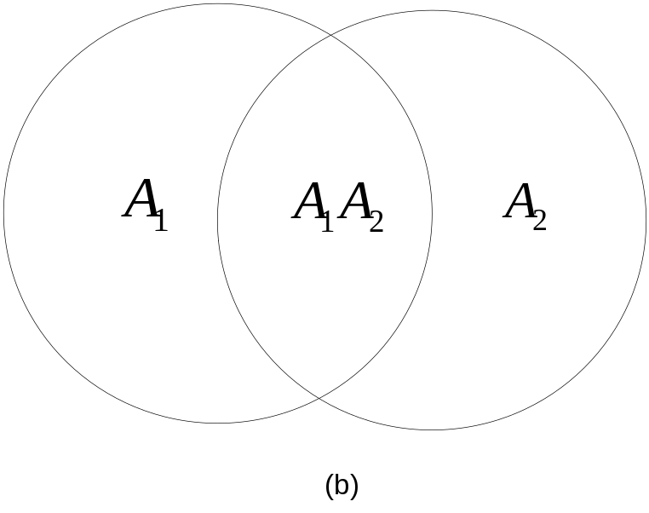
Figure 12-2(b). Events that are not mutually exclusive.

Slide 12
Events that are not
Mutually Exclusive
If the two events are not mutually exclusive, then the common area must be subtracted from the sum of the probabilities.

Slide 13
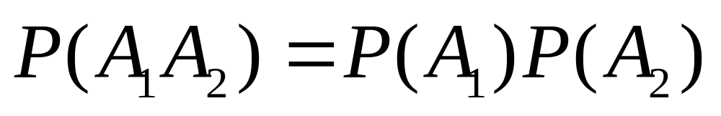
Statistical Independence
Let P(A₁A₂) represent the probability that both A₁ and A₂ occur. Two events are statistically independent if

Slide 14
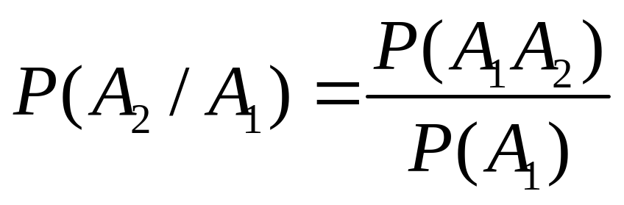
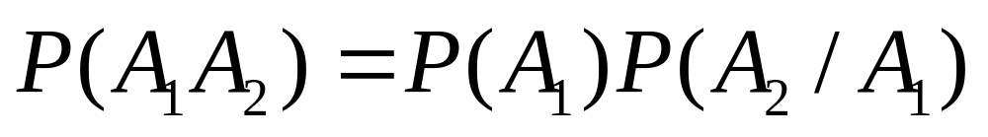
Conditional Probability
P(A₂/A₁) is defined to mean “the probability that A₂ is true given that A₁ is true.”

Slide 15
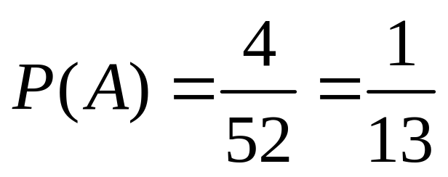
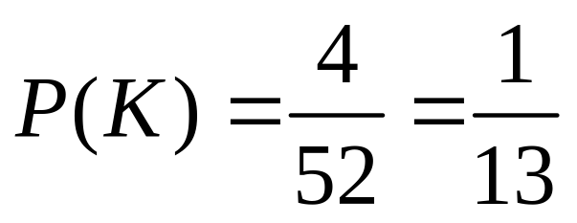
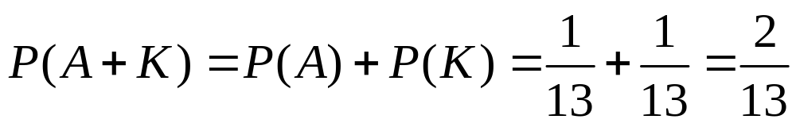
Example 12-2. What is the probability that a single card will be an ace or a king?

Slide 16
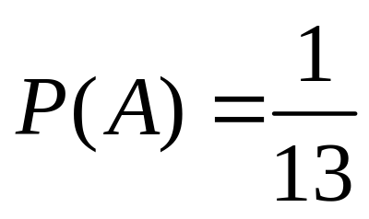
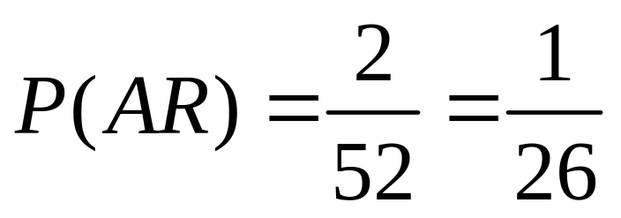
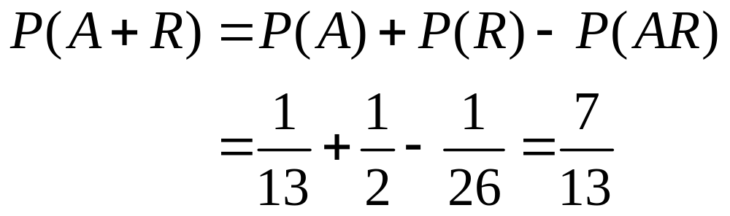
Example 12-3. What is the probability that a single card will be an ace or a red card?

Slide 17
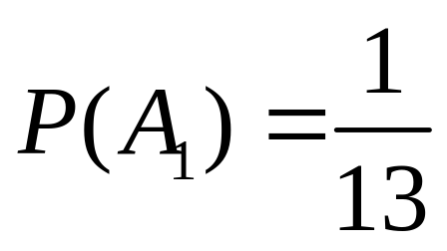
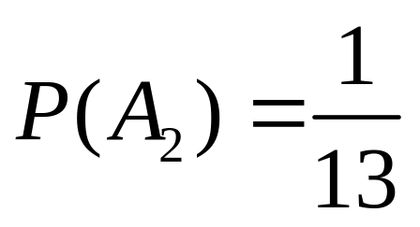
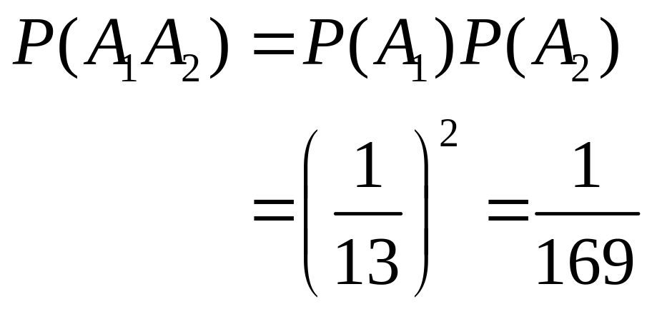
Example 12-4. Two cards are drawn from a deck. The first is replaced before the second is drawn. What is the probability that both will be aces?

Slide 18
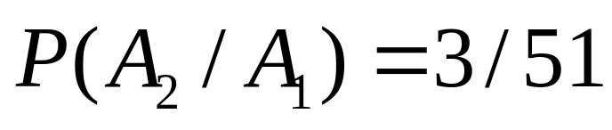
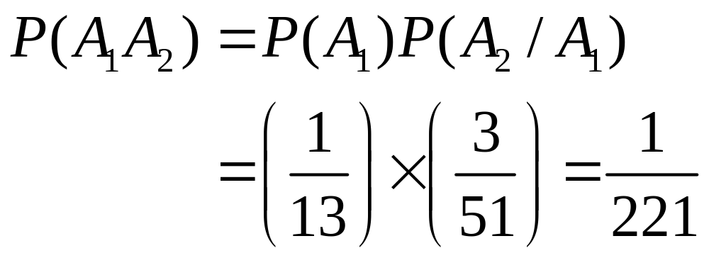
Example 12-5. Consider the same experiment but assume the first card is not replaced. What is the probability that both will be aces?

Slide 19
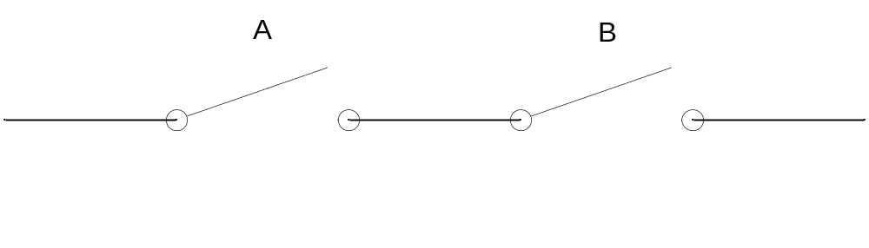
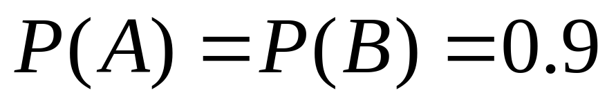
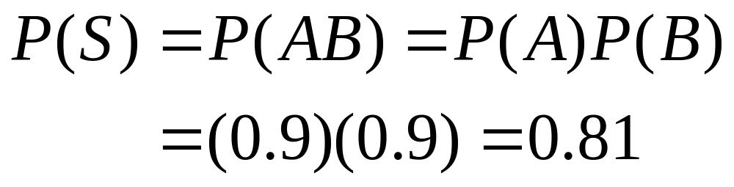
Example 12-6. The switches below are SI and only close 90% of the time when activated. Determine probability that both close.

Slide 20
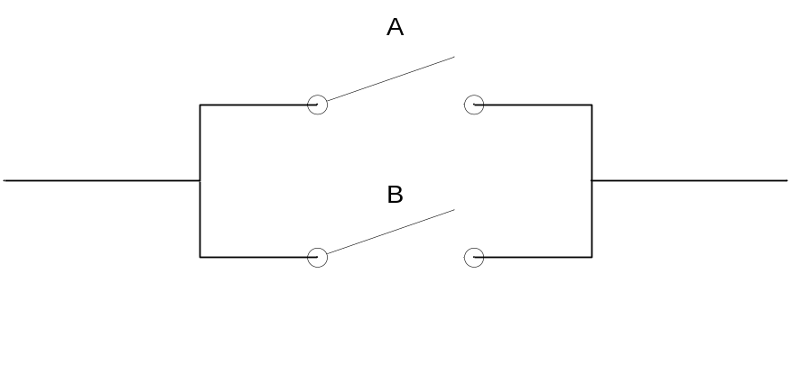
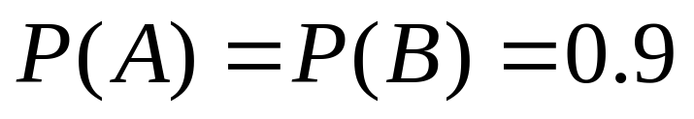
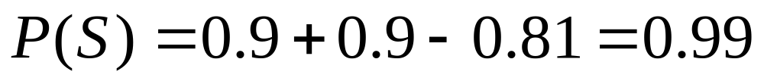
Example 12-7. The switches are changed as shown. Determine the probability of success.

Slide 21
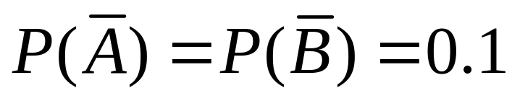
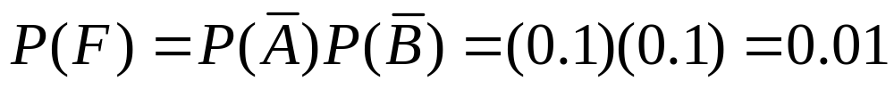
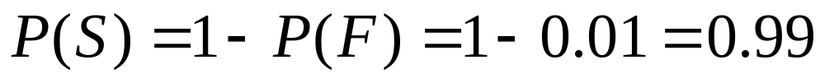
Example 12-7. Alternate Solution.

Slide 22
Discrete Statistical Functions
A discrete variable is one that can assume only a finite number of levels. For example, a binary signal can assume only two values: a logical 1 and a logical 0. To develop the concept, consider a random voltage x(t) that can assume 4 levels. The values are listed below and a short segment is illustrated on the next slide.

Slide 23
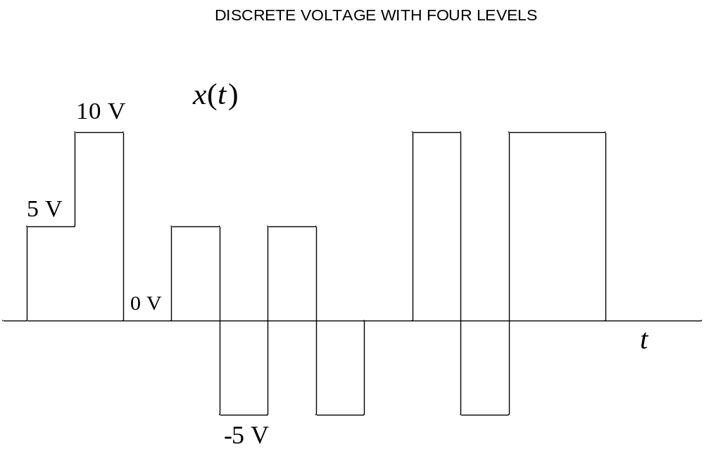
Figure 12-5. Short segment of random discrete voltage.

Slide 24
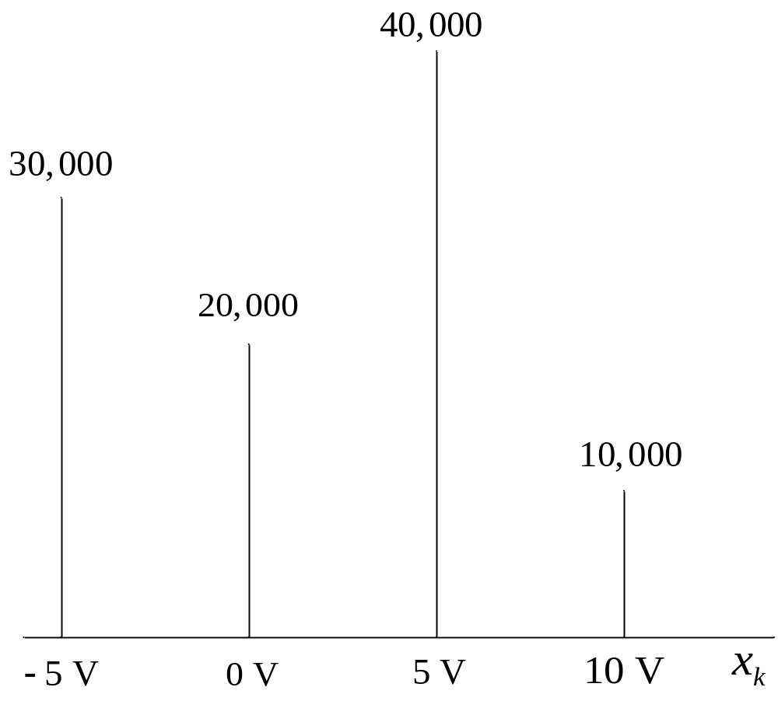
Figure 12-6. Number of samples of each voltage based on 100,000 total samples.

Slide 25
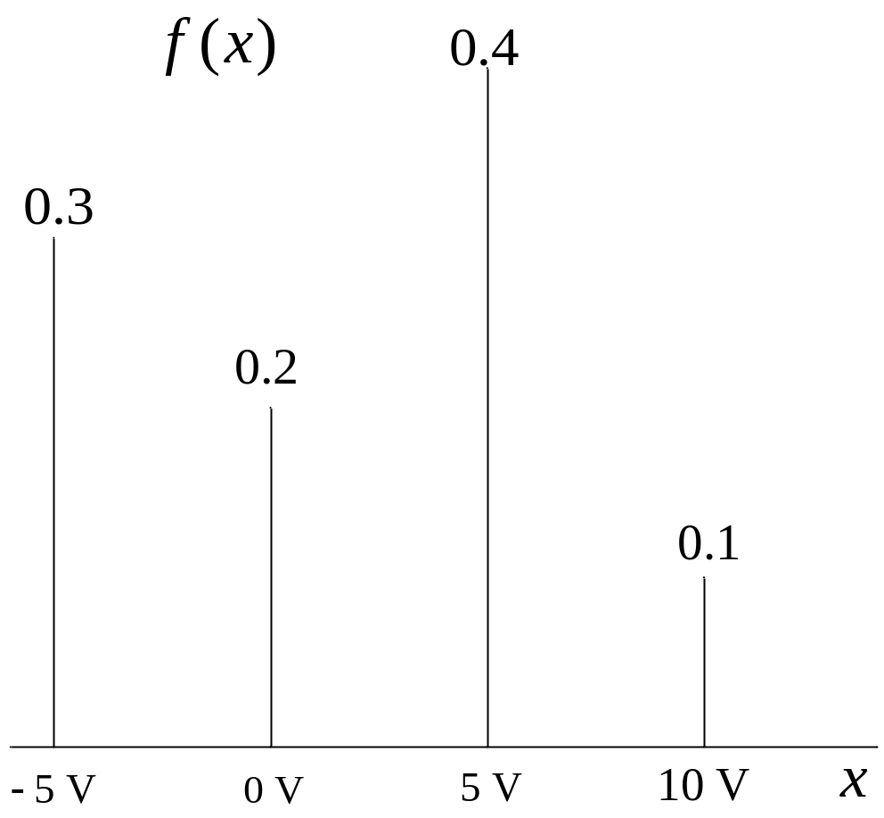
Figure 12-7. Probability density function (pdf) of random discrete voltage.

Slide 26
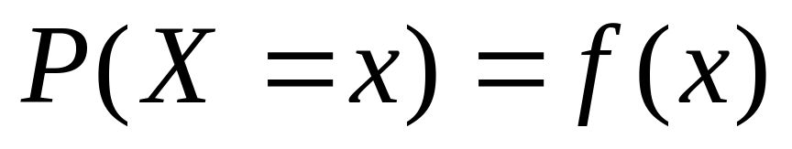
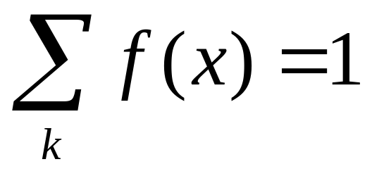
Probability Evaluations
The quantity X represents a random sample of a process. The expression P(X=x) means “the probability that a random sample of the process is equal to x.”

Slide 27
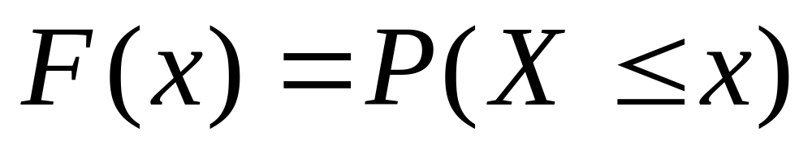
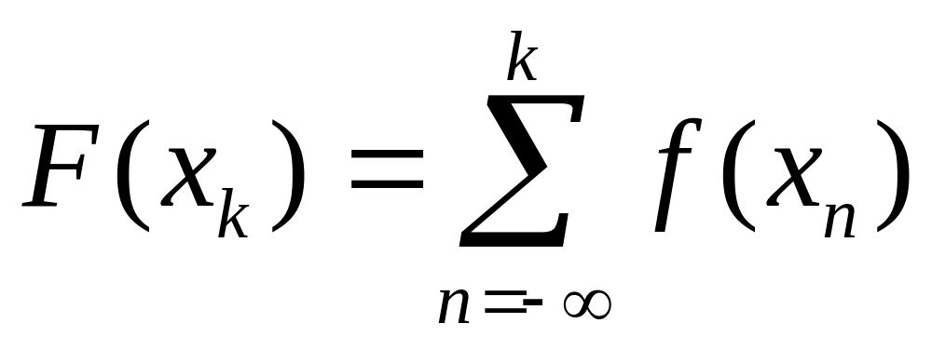
Probability Distribution Function F(x)

Slide 28
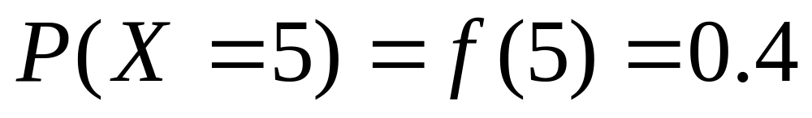
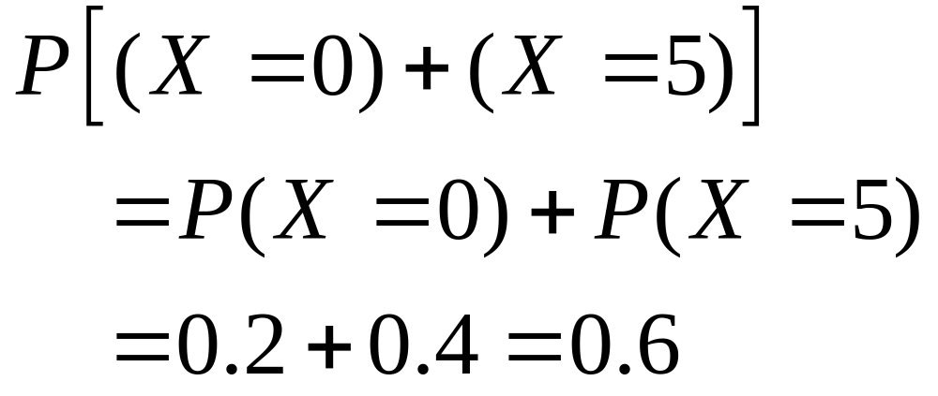
Example 12-8. For the pdf considered earlier, determine the probability values in the statements that follow.

Slide 29
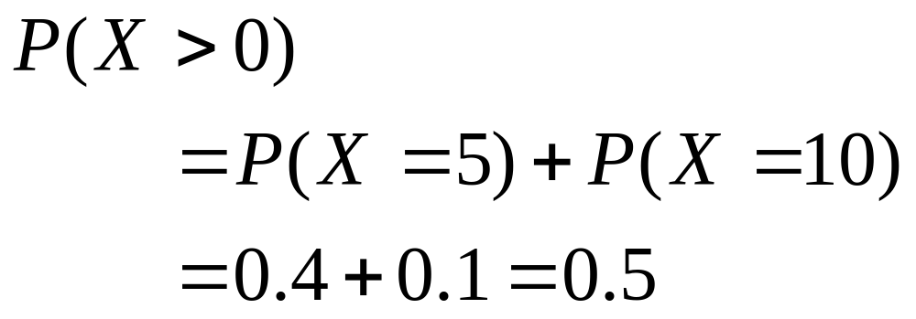
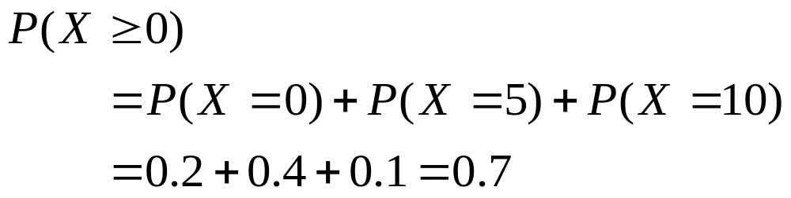
Example 12-8. Continuation.

Slide 30
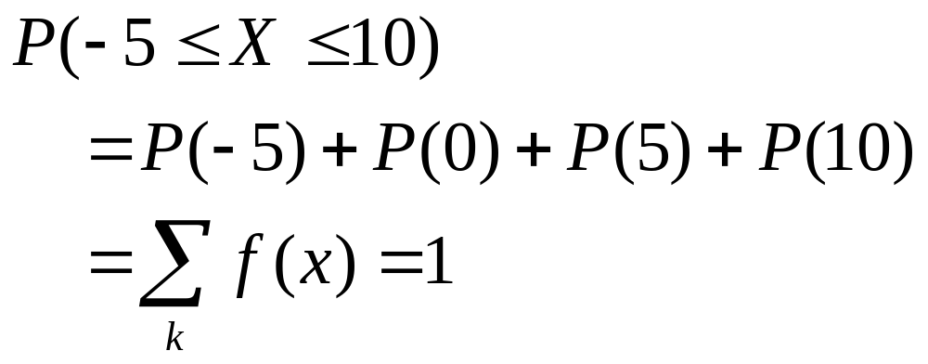

Example 12-8. Continuation.

Slide 31

Example 12-9. Determine the probability distribution function of the random discrete voltage.

Slide 32

Statistical Averages of Discrete Variables.
In dealing with statistical processes, there is a difference between a complete population and a sample of a population insofar as parameter estimation is concerned. We will assume here that we are dealing with a complete population.
Expected Value or Expectation

Slide 33



Statistical Averages of Discrete Variables. Continuation.
Mean Value
Mean-Squared Value
Root-Mean Square (RMS Value)

Slide 34



Statistical Averages of Discrete Variables. Continuation.
Variance
Alternate Formula for Variance
Standard Deviation

Slide 35


Example 12-10. For pdf of Example 12-8, determine (a) mean value, (b) mean-square value, (c) rms value, (d) variance, and (e) standard deviation.

Slide 36


Example 12-10. Continuation.

Slide 37


Binomial Probability Density Function
Consider the probability that in four trials, A will occur exactly twice. The different combinations are as follows:
AABB ABAB ABBA BBAA BABA BAAB

Slide 38

Combinations
The number of combinations of n trials with exactly x occurrences of one of the two outcomes, where x is a non-negative integer no greater than n, is given by

Slide 39



Binomial PDF

Slide 40

Example 12-11. An unbiased coin is flipped 3 times. What is the probability of getting exactly one head?

Slide 41

Example 12-12. For previous example, what is the probability of getting at least one head?

Slide 42


Example 12-12. Alternate Approach.

Slide 43


Continuous Statistical Functions
If the random variable x is continuous over a domain, it can be described by a continuous pdf. The probability of a sample assuming an exact value is 0.

Slide 44

Figure 12-9. Typical pdf of a continuous variable.

Slide 45



Probability Distribution Function F(x)

Slide 46

Figure 12-10. Probability of a random sample lying within a domain is the area under the pdf curve between the limits.

Slide 47




Example 12-13. Determine K below.

Slide 48


Example 12-14. For the pdf of the last example, determine the probability values in the statements that follow. Refer to Figure 12-12 if necessary.

Slide 49



Example 12-14. Continuation.

Slide 50

Figure 12-12. Various areas in Example 12-14.

Slide 51

Example 12-15. Determine the probability distribution function for the uniform pdf of Example 12-14.

Slide 52

Figure 12-13. Probability distribution function for Example 12-15.

Slide 53

Statistical Averages of Continuous Variables.
With discrete variables, the averages are determined by summations. With continuous variables, the averages are determined by integrals.
Expected Value or Expectation

Slide 54


Statistical Averages of Continuous Variables. Continuation.
Mean Value
Mean-Squared Value
Root-Mean Square (RMS Value)

Slide 55

Statistical Averages of Discrete Variables. Continuation.
Variance
Alternate Formula for Variance
Standard Deviation

Slide 56


Example 12-16. For uniform pdf of previous examples, determine (a) mean value, (b) mean-square value, (c) total rms value, (d) variance, and (e) standard deviation.

Slide 57


Example 12-16. Continuation.

Slide 58

Figure 12-14. Gaussian Probability Density Function.

Slide 59


Mathematical Properties of
Gaussian PDF

Slide 60




Normalized Gaussian PDF

Slide 61

Figure 12-15. Normalized Gaussian PDF.

Slide 62





Gaussian Probability Distribution Function

Slide 63


Slide 64
Example 12-17. In this example, the normalized gaussian pdf will be used to evaluate various probabilities that will be listed on the next several slides. Table 12-2 in the text will be used to determine the values required in the computations.

Slide 65



Example 12-17. Continuation.

Slide 66



Example 12-17. Continuation.
Alternately,

Slide 67


Example 12-17. Continuation.
Alternately,

Slide 68


Example 12-18. A random voltage x(t) is gaussian distributed with a dc value of 0 and an rms value of 5 V. Determine various probabilities listed in the steps that follow.

Slide 69


Example 12-18. Continuation.

Slide 70


Example 12-19. A random force has a gaussian distribution with a mean value of 10 N and standard deviation of 5 N. Determine the probability that a sample exceeds 20 N.

Slide 71

Example 12-19. Continuation.

Slide 72








Sampling Statistics
In all cases thus far, it has been assumed that the statistics of the complete population were known. In many applications, only a sample of the population can be obtained.
Parameter
True
Sample
Mean
Mean-Square
Variance
Standard Deviation

Slide 73


Sample Parameters
Sample Mean
Sample Mean-Square Value

Slide 74



Sample Parameters (Continued)
Sample Variance
or
Sample Standard Deviation

Slide 75
Other Sample Statistical Parameters
Median. The median is the midpoint value.
Mode. The mode is the most frequently occurring value.
Range. The range is the largest value minus the smallest value.

Slide 76


Example 12-20. In a large class, a sample of 25 grades taken at random resulted in the values below. Determine the sample statistics.
50 52 56 60 63 68 70 73 76 76 76 77 79 81 82 82 83 85 88 89 89 90 92 94 96

Slide 77


Example 12-20. Continuation.
alternate
method

Slide 78




Example 12-20. Continuation.

Slide 79

MATLAB Statistical Parameters

Slide 80
Example 12-21. Use MATLAB to solve Example 12-20.
>> xa = [50 52 56 60 63];
>> xb = [68 70 73 76 76];
>> xc = [76 77 79 81 82];
>> xd = [82 83 85 88 89];
>> xe = [89 90 92 94 96];
>> x = [xa xb xc xd xe];

Slide 81
Example 12-21. Continuation.
>> xmean = mean(x)
xmean =
77.0800
>> xmedian = median(x)
xmedian =
79

Slide 82
Example 12-21. Continuation.
>> xstd = std(x)
xstd =
12.9933
>> xmean_square = mean(x.^2)
xmean_square =
6.1034e+003

Slide 83



Gaussian Probabilities Using the Error Function

Slide 84


Complementary Error Function

Slide 85
Summary of MATLAB Error
Function Commands
Error Function: erf(x)
Inverse Error Function: erfinv(x)
Complementary Error Function: erfc(x)
Inverse Complementary Error Function: erfcinv(x)

Slide 86
Inverse Operations with MATLAB
To find the value of z such that P(Z ≤ z) = p, the following MATLAB command is used:
>> z = sqrt(2)*erfinv(2*p - 1)
To find the value of z such that P(Z ≥ z) = p, the following MATLAB command is used:
>> z = sqrt(2)*erfcinv(2*p)

Slide 87
Example 12-22. Rework the first four parts of Example 12-17 using MATLAB.
>> k = sqrt(2);
(a) P(Z ≥ 0)
>> pa=.5*(erf(10/k) - erf(0))
pa =
0.5000
(b) P(1 ≤ Z ≤ 3)
>> pb = 0.5*(erf(3/k) - erf(1/k))
pb =
0.1573

Slide 88
Example 12-22. Continuation.
(c) P(-1 ≤ Z ≤ 2)
>> pc = 0.5*(erf(2/k) - erf(-1/k))
pc =
0.8186
(d) P(-2 ≤ Z ≤ 2)
>> pd = 0.5*(erf(2/k) - erf(-2/k))
pd =
0.9545

Slide 89


Example 12-23. An internet line has noise with a dc value of 0 and an rms value of 2 V. An error occurs if the noise exceeds a threshold. Determine threshold for p = 10⁻⁵.
>> z = sqrt(2)*erfcinv(2*1e-5)
z =
4.2649

Slide 90


